Slide 1
Ansys| Cornelis Networks Partner Offerings (Battle Cards)
2024
Cornelis Networks
© Cornelis Networks | Confidential
Notes:
Source document: https://cornelisnetworks-my.sharepoint.com/:w:/p/mjacobs/EVaaXgl_mmlDq8R8WNZ-xuoB2kSscZX5zO2MRc_lbQN8kA?e=94j1FH

Slide 2
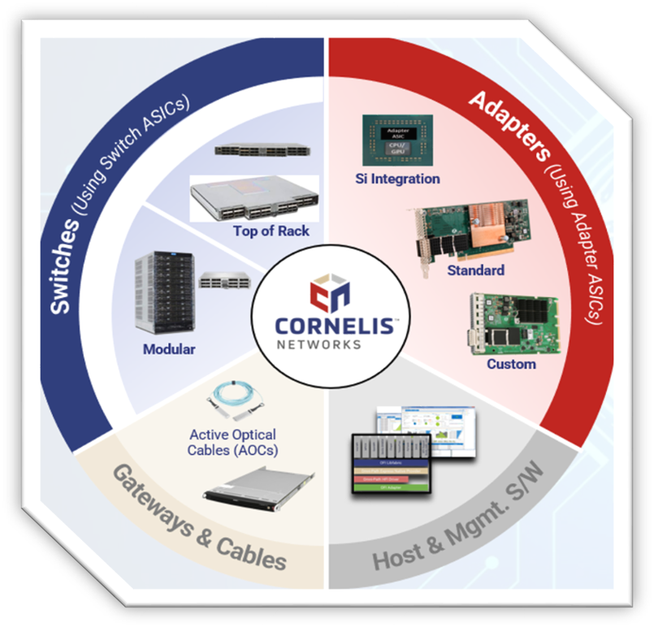
Ansys and Cornelis Networks Working Together to Deliver:
Industry-leading fabrics for AI, Data Analytics, and HPC
Market Analysis
Target Market & Industries
Large and Fast-growing markets
AI – $515B at 21.6% CAGAR
HPC - $41B at 8.1% CAGAR
AI & HPC placing extreme demands on networks
Data, increased scale
High-performance interconnects required to unlock potential of workloads
Production-scale AI
Data analytics and HPC
Government
Manufacturing
Transportation
OPX delivers 2x higher performance per fabric cost on Ansys LS-DYNA car2car*
Energy (oil & gas)
Life Sciences
Higher Education
Climate
AI/ML
Cloud Deployments
*compared to HDR200
Value to Ansys
Lower lead time
Speed time to revenue
Higher Performance
Offer differentiated value to customers
Better price performance
Improve customer offering
Improve margins
Unprecedented ease of use
Broad support for OS and Applications
Ease of use - it just works
Independent interconnect supplier
Freedom of choice
Highly interoperable
Competitive Positioning
Qualifying Sales Questions
Predictable Performance at Scale
Delivering the production-scale performance to drive the future of AI and HPC workloads where Ethernet and Infiniband fall short.
Nvidia Infiniband
OPA Scales better, performs better, better price-performance and availability.
HPE Slingshot
OPA performs better because not Eth based, better price-performance
Atos BXI
OPA is more open, performs better and scales better
Does your customer have HPC, AI, or data analytics application requirements?
Does your customer: Require high bandwidth, low latency networking
products to improve performance and scalability?
Contact sales@cornelisnetworks.com
Further information: scott.hurst@cornelisnetworks.com
Copyright Cornelis Networks. All Rights Reserved
Notes:
Penguin Solutions: Slide 7

Slide 3
Ansys and Cornelis Networks Working Together to Deliver:
High-Performance Scale-Out Interconnects for AI, Data Analytics, and HPC
Enhancing Ansys AI Strategy
Cornelis Networks
Partner Offering
Cornelis Networks Solution catalyzing the next wave of innovation in AI with CN5000
Designed for AI workloads - highest performance up to 400Gb
Seamless scalability for training large models - 330K nodes in 2024
Lowest latency communication between compute nodes
Transfer and aggregate data reliably and rapidly
Broad interoperability with AI infrastructure ecosystem
Open software integrates with hyperscale management frameworks
Cornelis Networks provides open, intelligent, high-performance networking solutions designed to accelerate the world’s most demanding high performance computing applications
Partnership tools and resources
Full reseller programs
Pre-sales architecture services
Benchmarking services
Sales and Marketing collateral
Technical and sales training programs
Co-marketing programs
World-class support
Quick-ship and 400Gb Upgrade promotions
Cornelis Networks Value Prop
Resources
Best price/ performance for AI and HPC workloads
Better performance
4-6 week lead times for OPA 100
Increase node count
Increase gross margins
Improve competitiveness with reduced full solution price
Ansys POC
Babis Bakolias
Partner Manager
Babis.bakolias@ansys.com
Cornelis Networks POC
Scott Hurst
Software Partnerships Lead
scott.hurst@cornelisnetworks.com
Cornelis Networks Advantage
Industry leading performance
Industry leading price/performance
Immediate availability for shipment
Unprecedented ease of use
Fully Integrated, Open, Interoperable
All products are TAA compliant
Copyright Cornelis Networks. All Rights Reserved
Notes:
Penguin Solutions: slide 8

